Slide 1

Queen Elizabeth High School
Open House 2026

Slide 2


Slide 3
Welcome - Administration
Principal: Ms. Jennifer Edmondson-Neily
Assistant Principal: Ms. Aimee Furey (Grades 8, 9, 12 in 2026/27)
Assistant Principal: Mr. Jason Stroh
(Grades 7, 9 11 in 2026/27)

Slide 4
Transition Team
Office Staff
Ms. Fiolka, Ms. Tarry
Student Services Team
Ms. Brock, Ms. Meville
Grade 7 Learning Leader
Ms. Norcross

Slide 5
About Us!
Only Grade 7 –12 school in the CBE
Community Program
DHH Program
GATE Program for North Calgary
Two CBE Mental Health Classes
One RISE class
Offers AP (Advanced Placement) Classes including the Capstone Diploma
Vibrant International Student population
Junior High students are organized into Learning Communities

Slide 6
Jr. High Timetables
Grade 7 & 8
8:55-11:56 – Learning Community*
11:56-12:32 – Lunch
12:32-2:01 – Option Block
2:04-3:33 – Option Block
Grade 9
8:55-10:24 – Core
10:27 - 11:56 – Option Block
11:56 -12:32 – Lunch
12:32 - 2:01 – Core
2:04 - 3:33 – Phys Ed/Health & Wellness
Learning Community structures create belonging and connection, allow for Math/Science and ELA/Social Studies (Humanities) approach to support cross curricular connections and common tasks. Students in grade 7 and 8 have their Physical Education daily for 45 minutes in their learning community block.

Slide 7
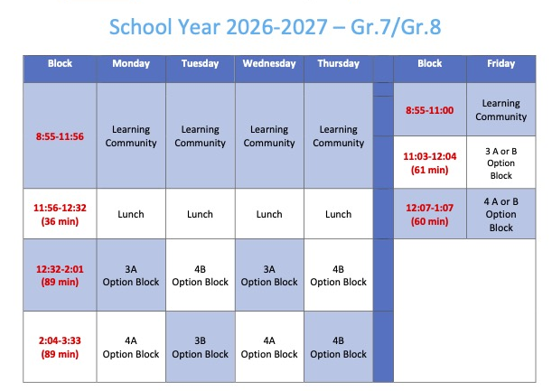

Slide 8
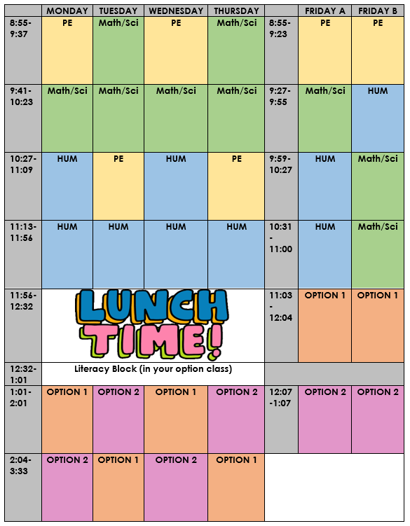

Slide 9
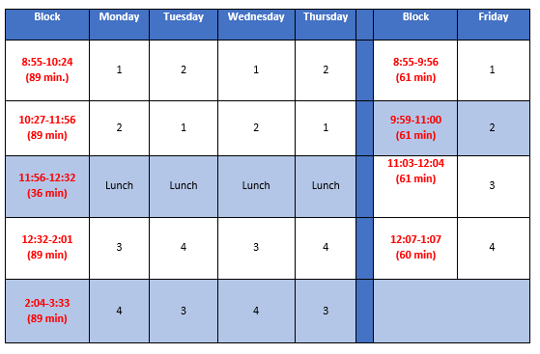
High School Timetable
Two semesters each year
Classes change each semester

Slide 10
Complementary Classes
Grade 7 Wheel
  Art, Drama, Foods, Electro-Tech, Outdoor Ed, ASL, Health, Comm Tech
  Optional: Band, French, Power Up
Grade 8 & 9 Courses
  Training for Sport, Outdoor Ed, Leadership, Fashion Studies, Band, French, Art, Drama, Construction, Foods, Comm Tech, Electro-Tech, Design Studies, Power Up
High School Courses
  ASL, French, Chinese Band, Outdoor Education, Culinary Arts, Construction, Psychology, Design Thinking for Innovation, Photography, Military Studies, Robotics, Computer Science, Art, Capstone AP Diploma, Sports Medicine, Sports Performance, and Work Experience

Slide 11

Clubs & Athletics – Get Involved!
Newspaper Club
Gardening Club
Robotics
Student Advocacy
GSA
Math Contests
Chess Club
Anime Club
Debate Club
Baking Club
D&D Club
Model UN
Cross Country Running
Badminton
Volleyball
Basketball
Track & Field
Flag Football
Field Hockey
Soccer
Follow us on Instagram @qehsknights

Slide 12
Transportation
Yellow School Bus Registration is Now Open for 2026-27
To ensure service is in place for the first day of classes, registrations must be received by Sunday, June 14. Access to bus routes may be delayed for registration after this date. Of note:
A banner story outlining service levels and proposed fees has been posted to the corporate and school websites.
Confirmed bus routes will be posted for families who registered by the deadline in MyCBE in late August.
The transportation fee has increased from $360 to $500/rider.

Slide 13
First Day of School
Monday, August 31st
8:55 – 11:56 Grades 7, 8, 9 Only
* Due to modified schedule, junior high students will need transportation home
12:32 – 3:33 High School Students Only
Grade specific information will be sent out to families through School Messenger in June and August

Slide 14
Open House & School Tours
The school is open to tour.
Tour Guides are located in the SGA and are wearing yellow shirts.
Most staff are wearing Knights clothing, so please feel free to ask them questions.
Tours run until 6:45 PM.
6:15 – 7:00 Program Presentations
GATE Presentation in the Learning Commons (For GATE students)
Deaf and Hard of Hearing – Room 201

